Slide 1
Dismounts & Tactics
Pages 57-71

Slide 2
Performance Objectives
List the ways to dismount the bicycle
Identify the 6 defensive bike tactics
Demonstrate the 6 bike tactics

Slide 3
Dismounts
Left side crossover
Step off
Kickstand
Left side crossover, foot through
Top tube dismount
Powerslide dismount

Slide 4
Dismounts
Start the Left Side Crossover by standing up on the pedals.
Lift the right foot out of the toe clip
Swing right leg over the back of the bike and bag (Open the hips, similar to a hurdlers position)
May need to push the bike away from you to keep balance
Tuck right foot behind left foot
When stopped, put the right foot down or put kickstand down. Then remove the left foot from the toe clip and place on the ground

Slide 5
Dismounts
Start the Left Side Crossover, Foot Through the same way as a left side dismount.
Instead of tucking your right foot behind the left, step through your left leg and the bike
This puts your right foot in front of the left foot
Allows you to dismount and run towards the violator
Very fast dismount without loss of momentum

Slide 6
Dismounts
Start the left side crossover, Top Tube the same way as a left side dismount.
Instead of swinging your right foot over the back, simply bring your right foot over the top tube
This puts your right foot in front of the left foot
Allows you to dismount and run towards the violator
Very fast dismount without loss of momentum

Slide 7
Dismounts
The Powerslide:
Riding and pick a spot to dismount
Smooth
Enough distance from violator
Right foot at 6 o’clock position
Lift left out of the toe clip
Use the rear brake to skid the rear tire
Lean left and place the left foot onto the ground
Turn / Pivot left around the left foot
Step out of right toe clip and exit the bike 180 degrees from the starting position

Slide 8
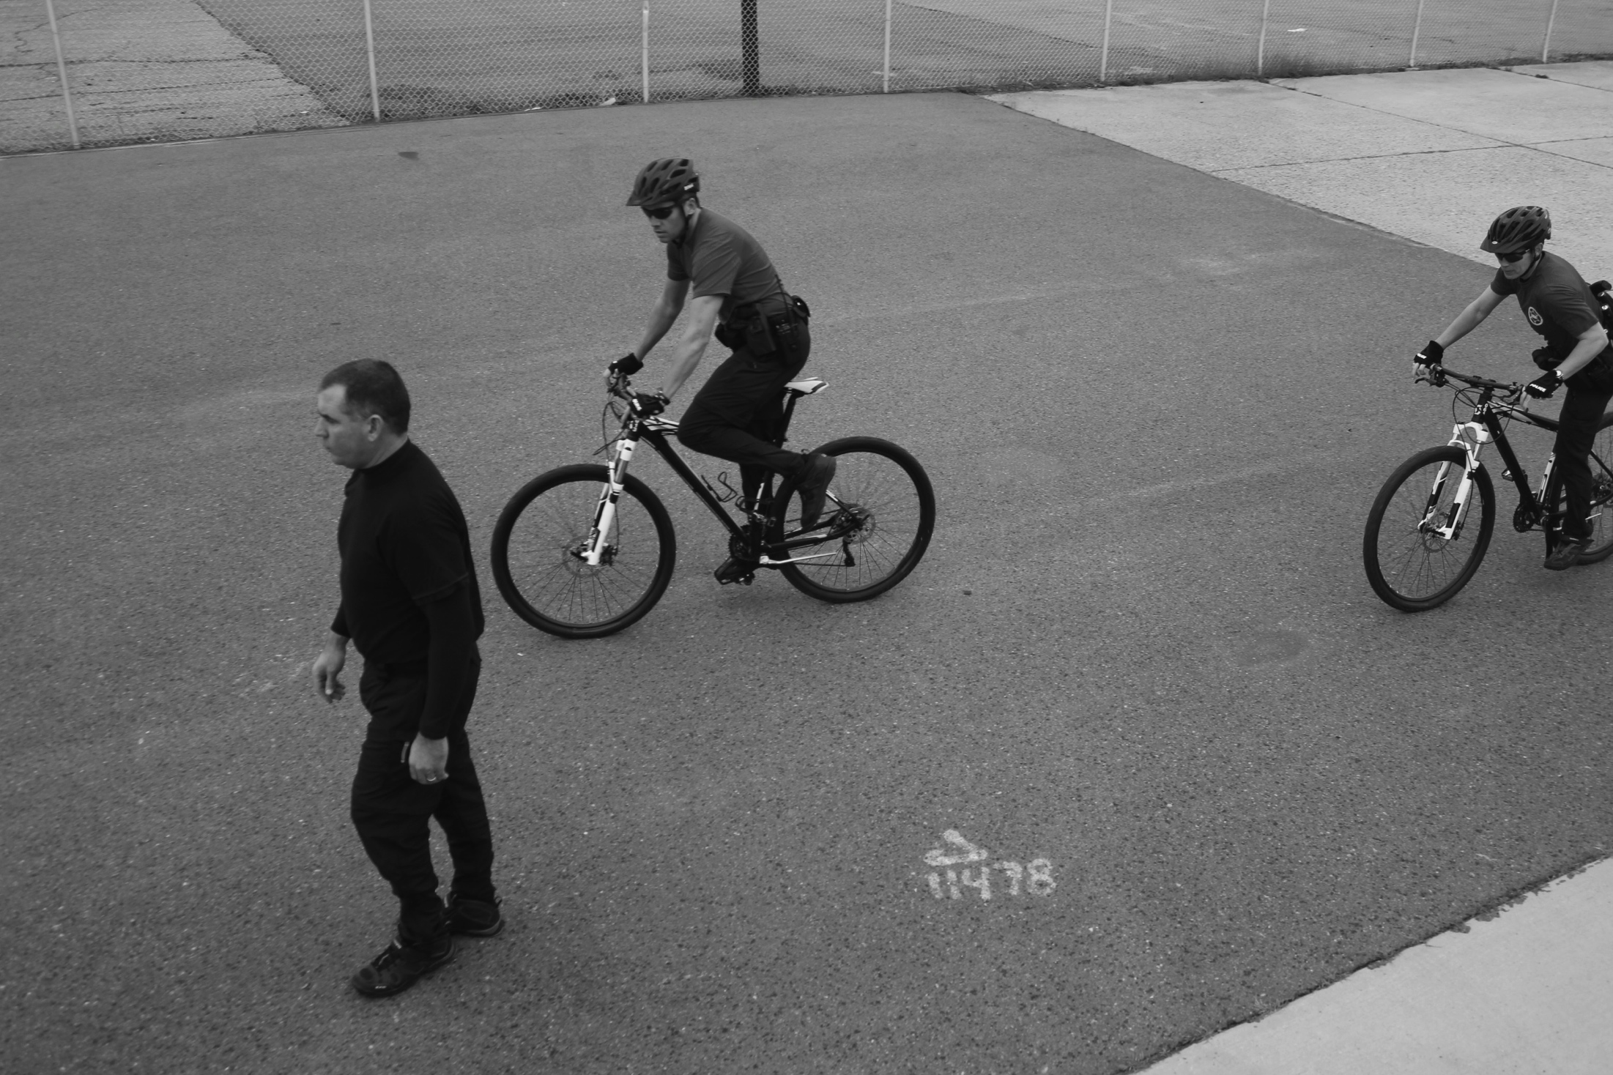
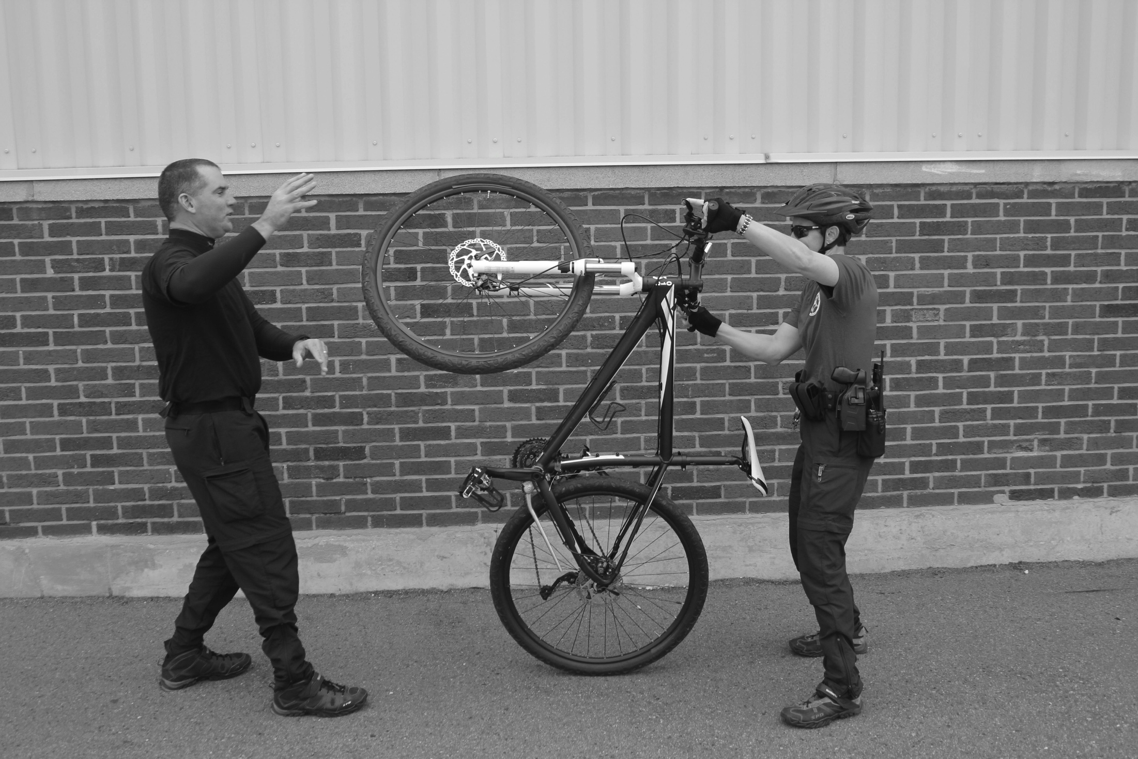
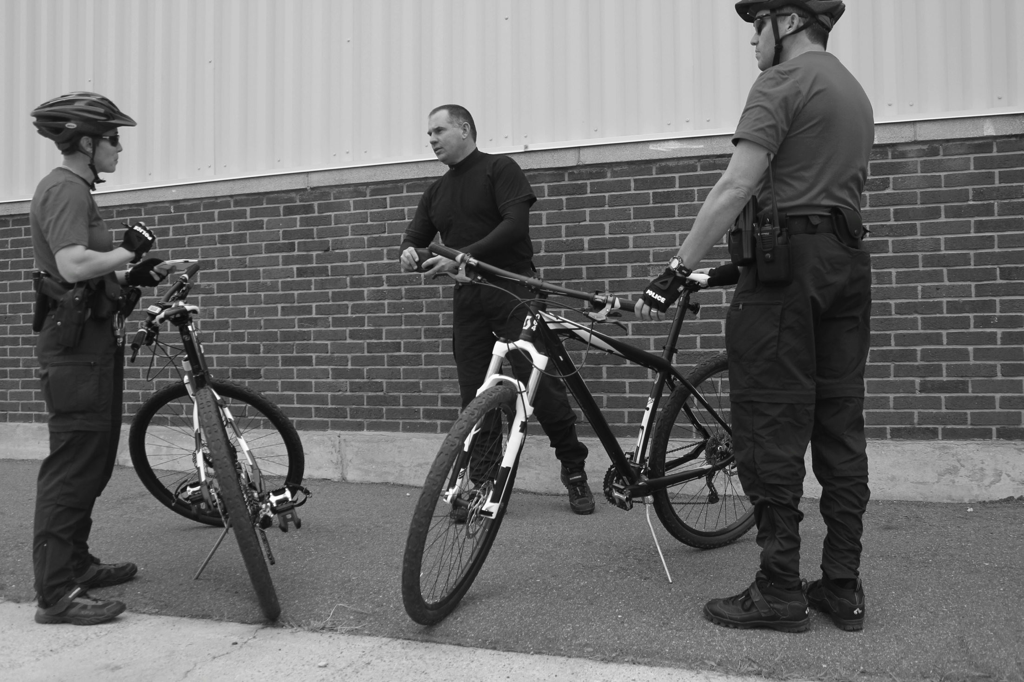
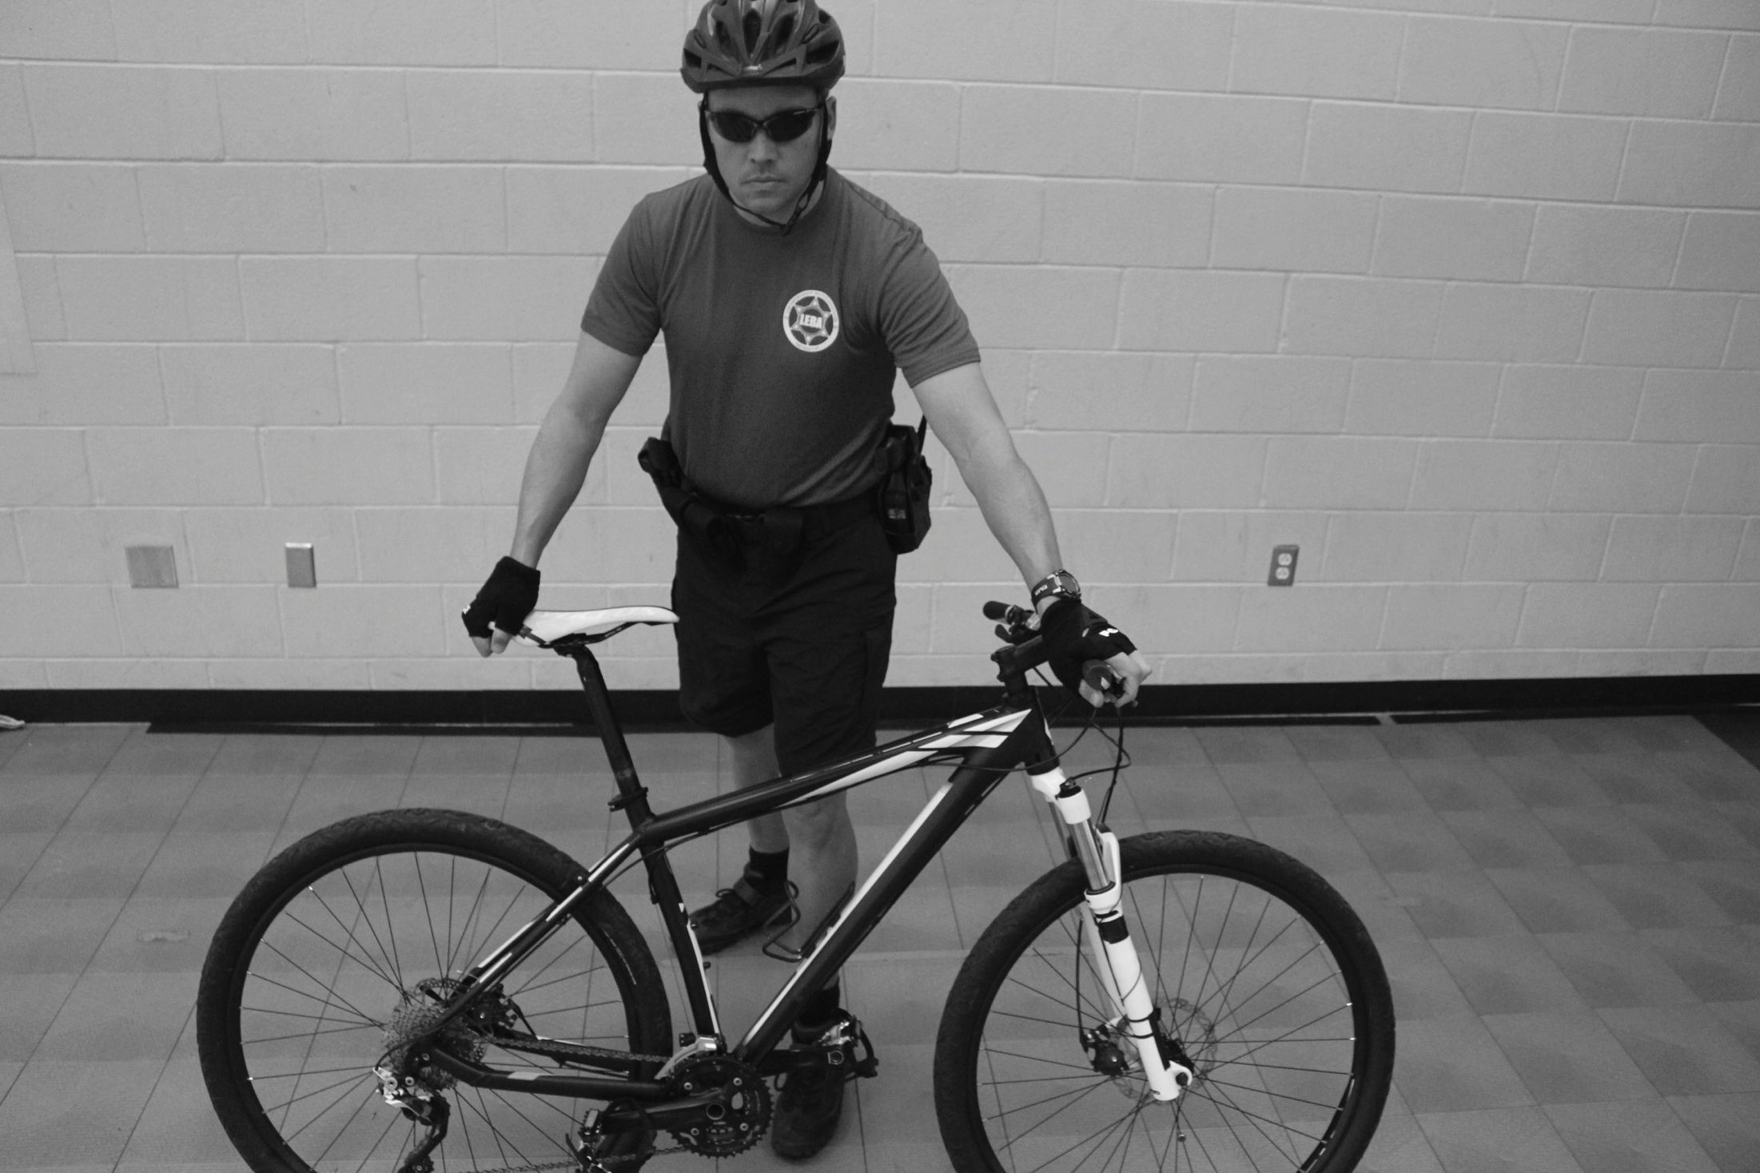
Tactics

Slide 9
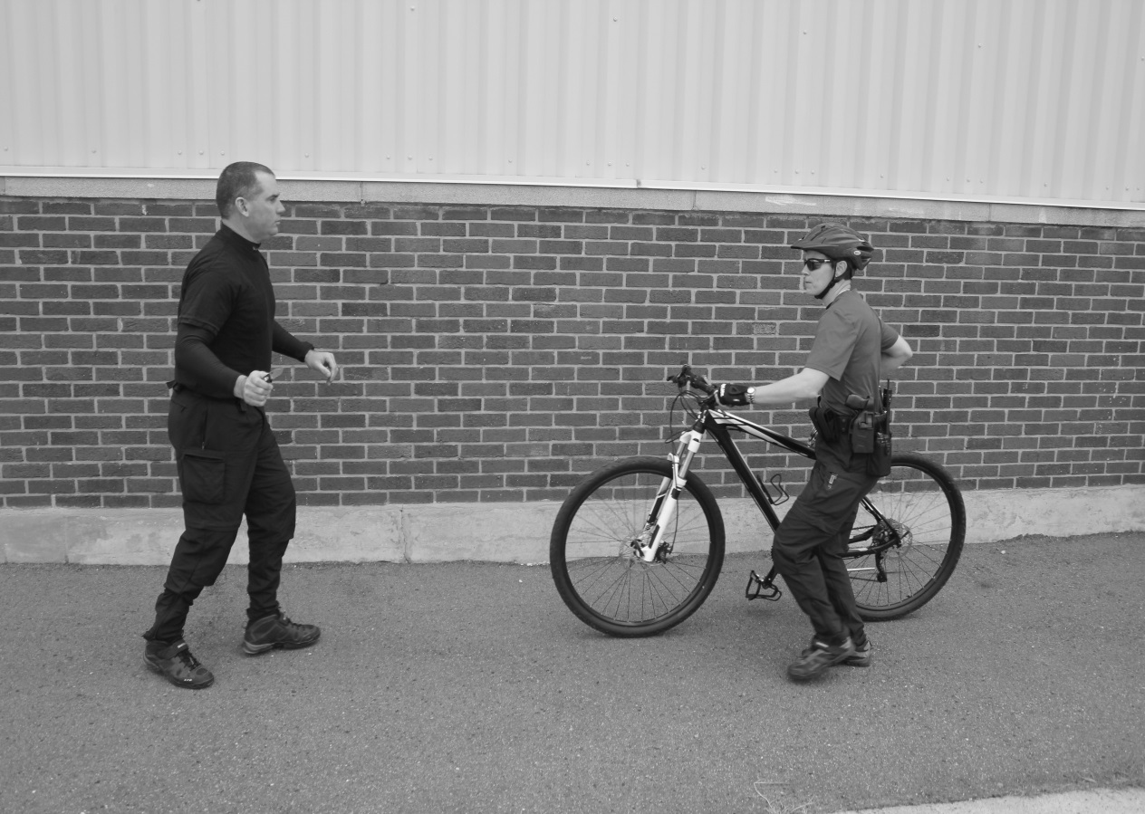
BIKE ROLL
From the Crossover Dismount Position and standing with the bike next to you.

Slide 10
BIKE ROLL
Violator produces a weapon, grab the seat with one hand while maintaining control of the bike.

Slide 11
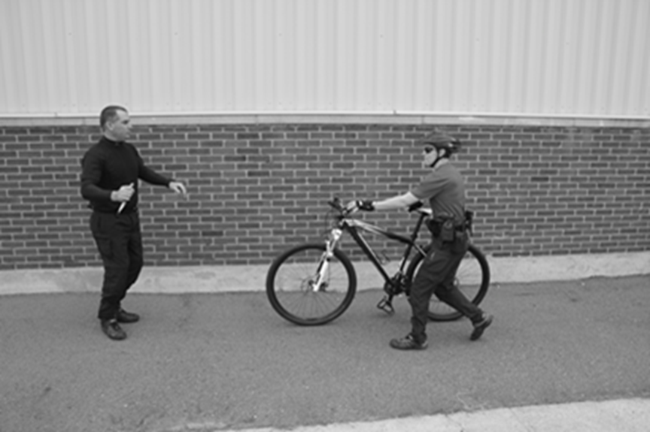
BIKE ROLL
Make sure you have good balance and prepare to roll bike towards violator.

Slide 12
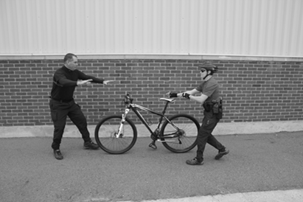
BIKE ROLL
Launch the bike by rolling it into the violator.

Slide 13
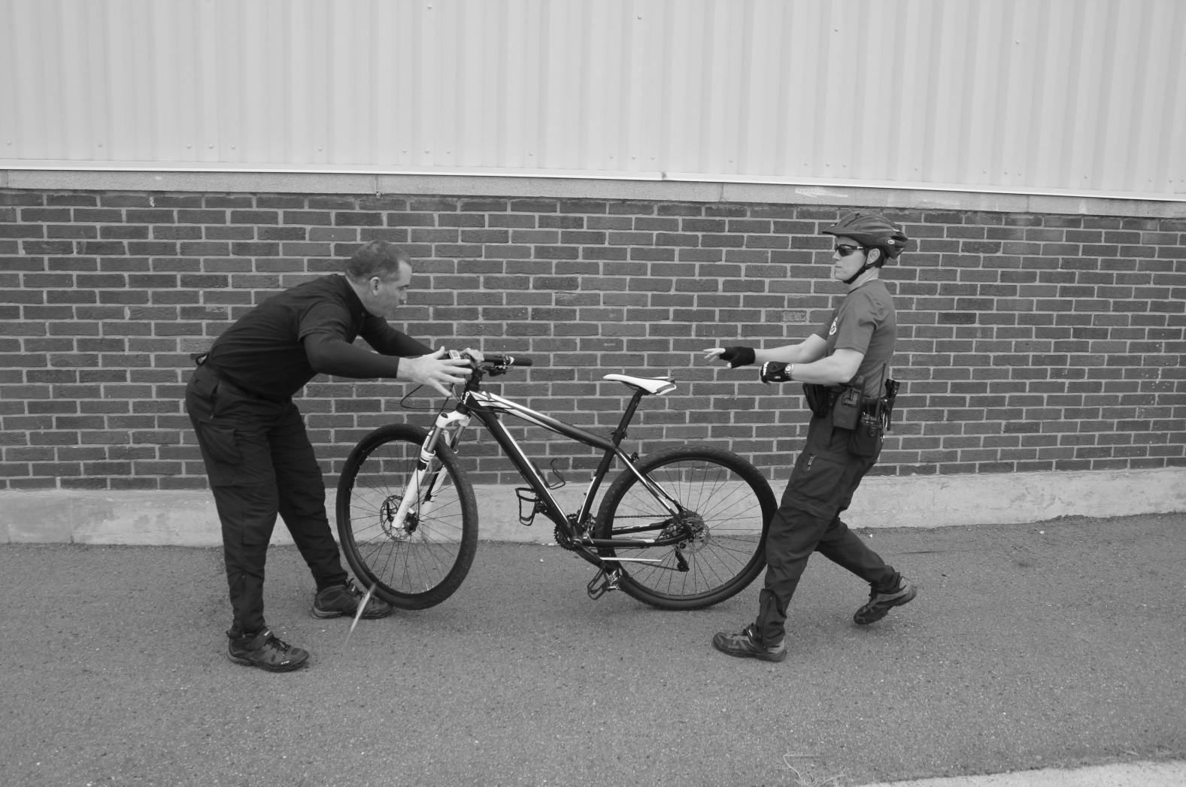
BIKE ROLL
Violator is distracted by the bike and you have time to determine an appropriate response.

Slide 14
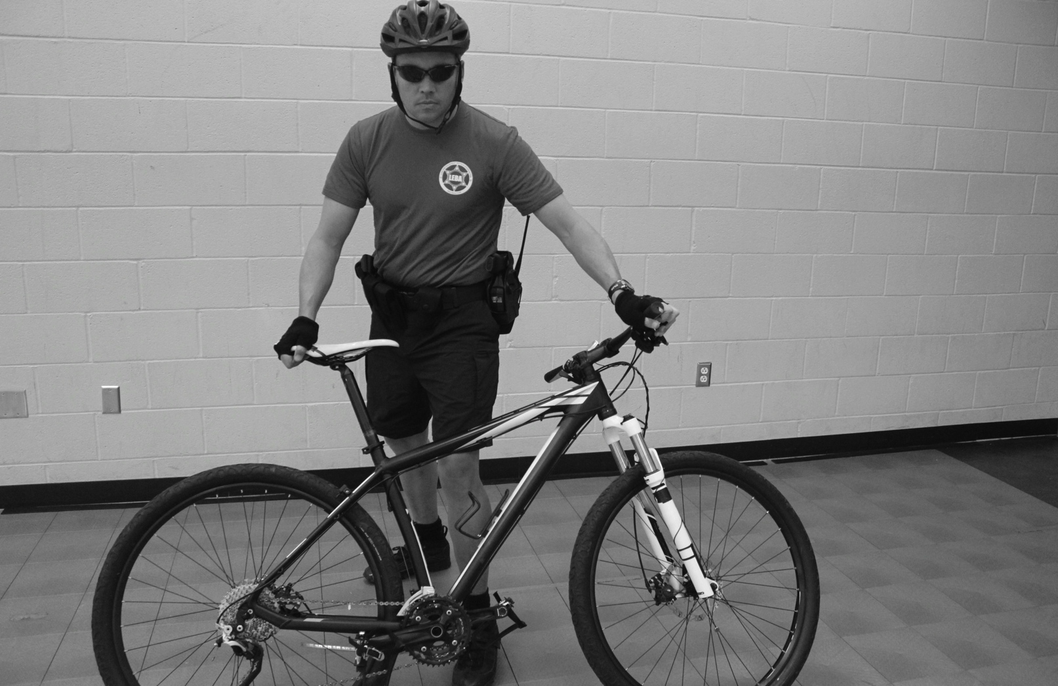
BIKE AS A BARRIER
From the Crossover Dismount Position Bring the Bike Between You and the “Violator”.

Slide 15
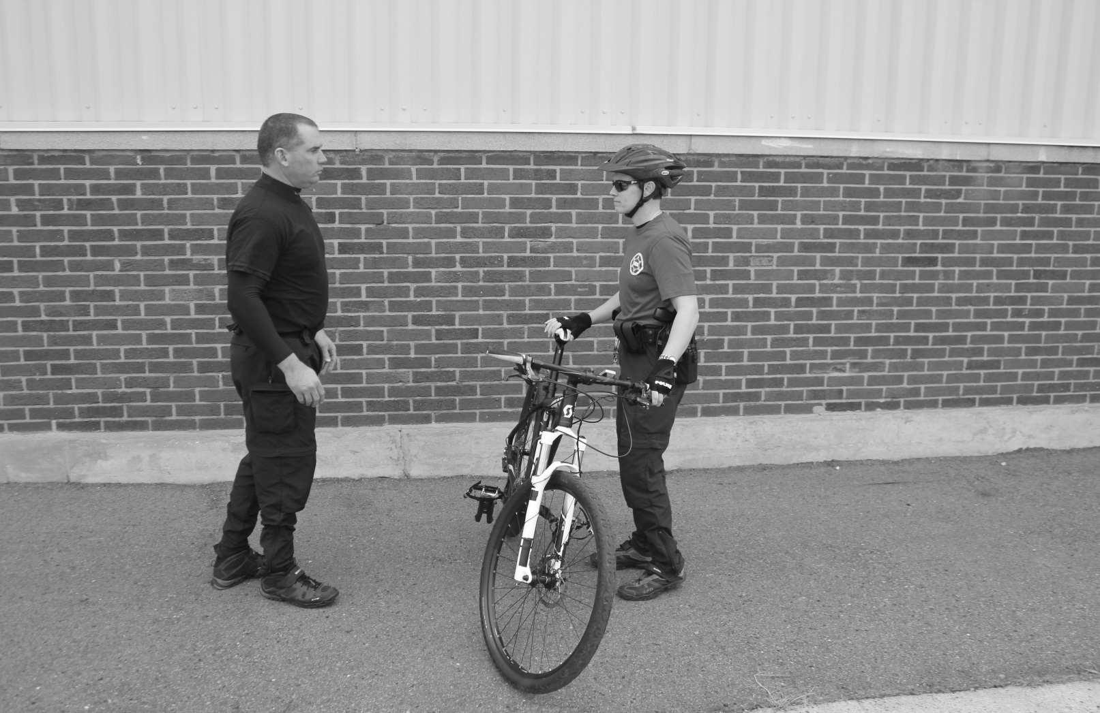
BIKE DROP
Bike is positioned as a barrier.

Slide 16
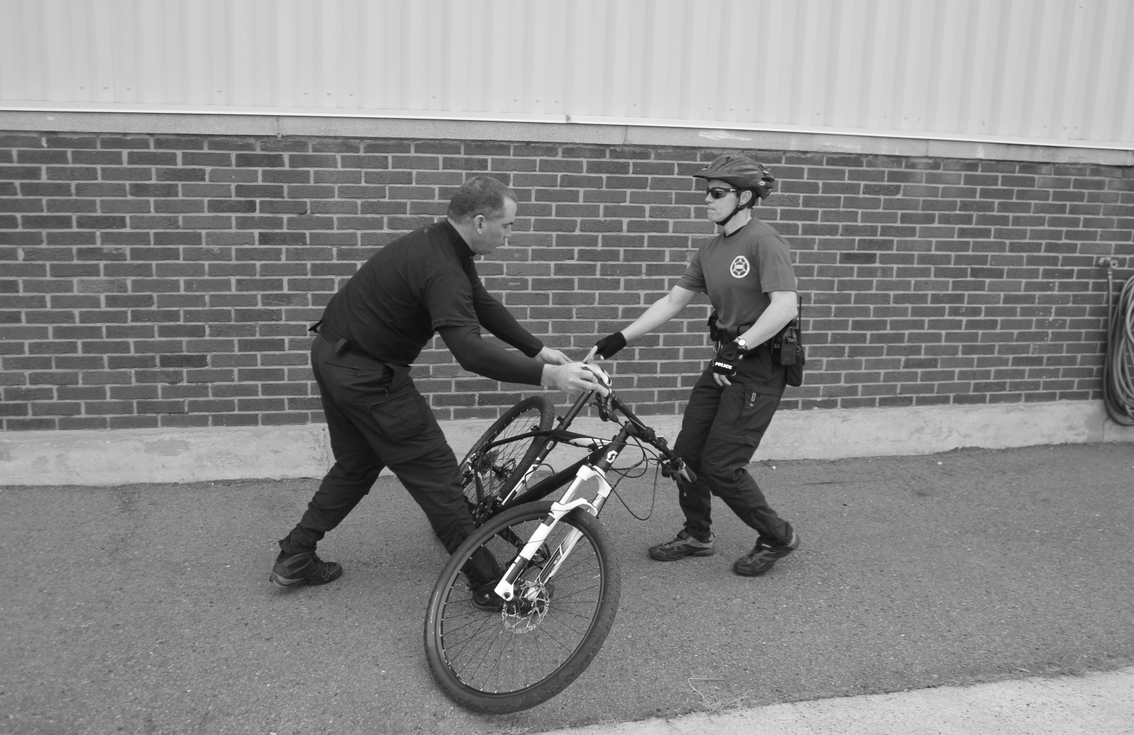
BIKE DROP
When the violator becomes aggressive, simply drop the Top Tube towards yourself and step back. If the kickstand is in use you will need to pull the bike towards yourself and over the kickstand.

Slide 17
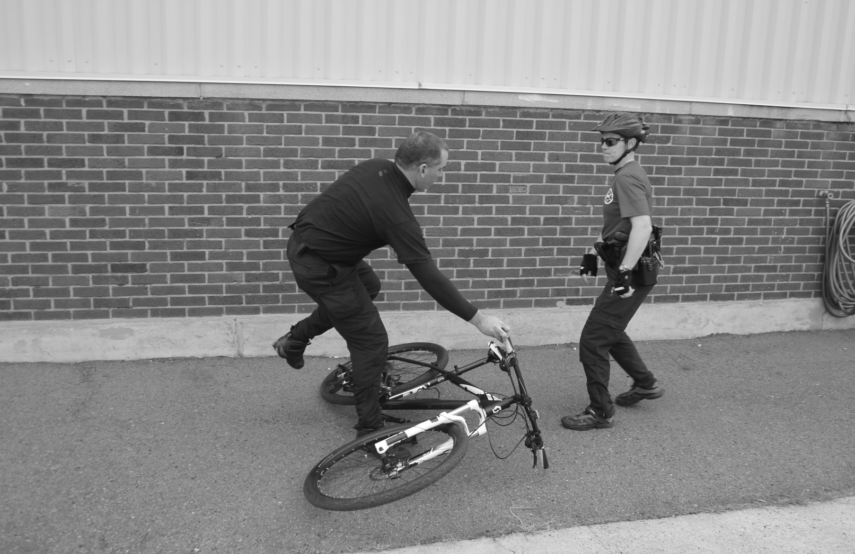
BIKE DROP
Dropping the bike gives the officer the ability to create distance from the violator and develop an appropriate response.

Slide 18
BIKE THROW
Bike is positioned as a barrier

Slide 19
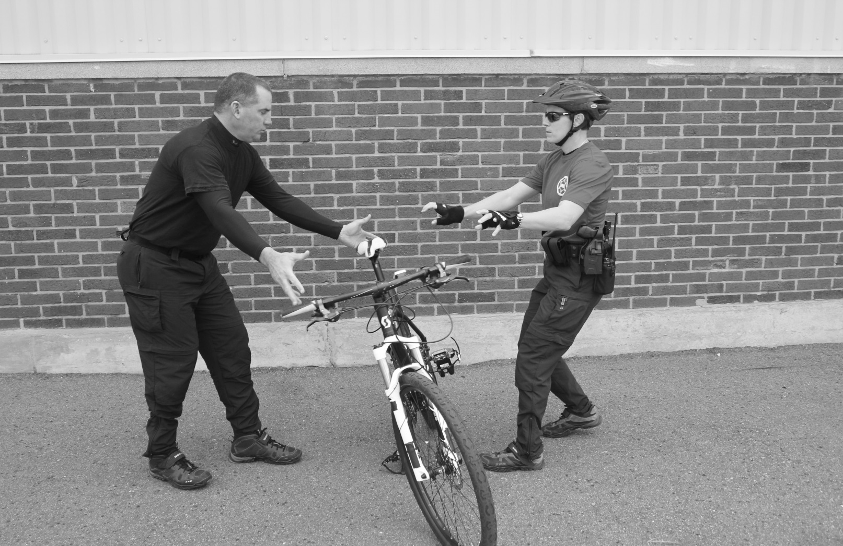
BIKE THROW
If a violator starts to approach you in an assaultive manner you have the option to push the bike toward them.

Slide 20
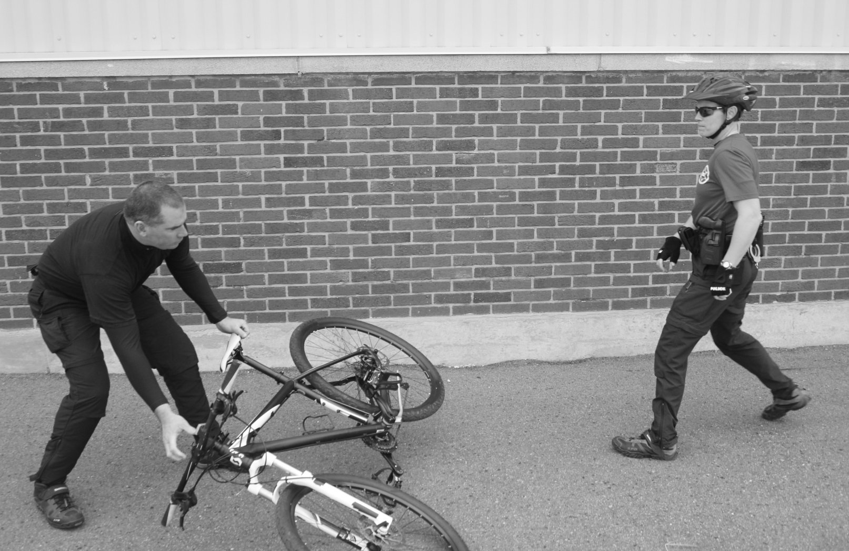
BIKE THROW
Timing in this maneuver is important, as you want the top of the bike to fall before the violator is too close to you.

Slide 21
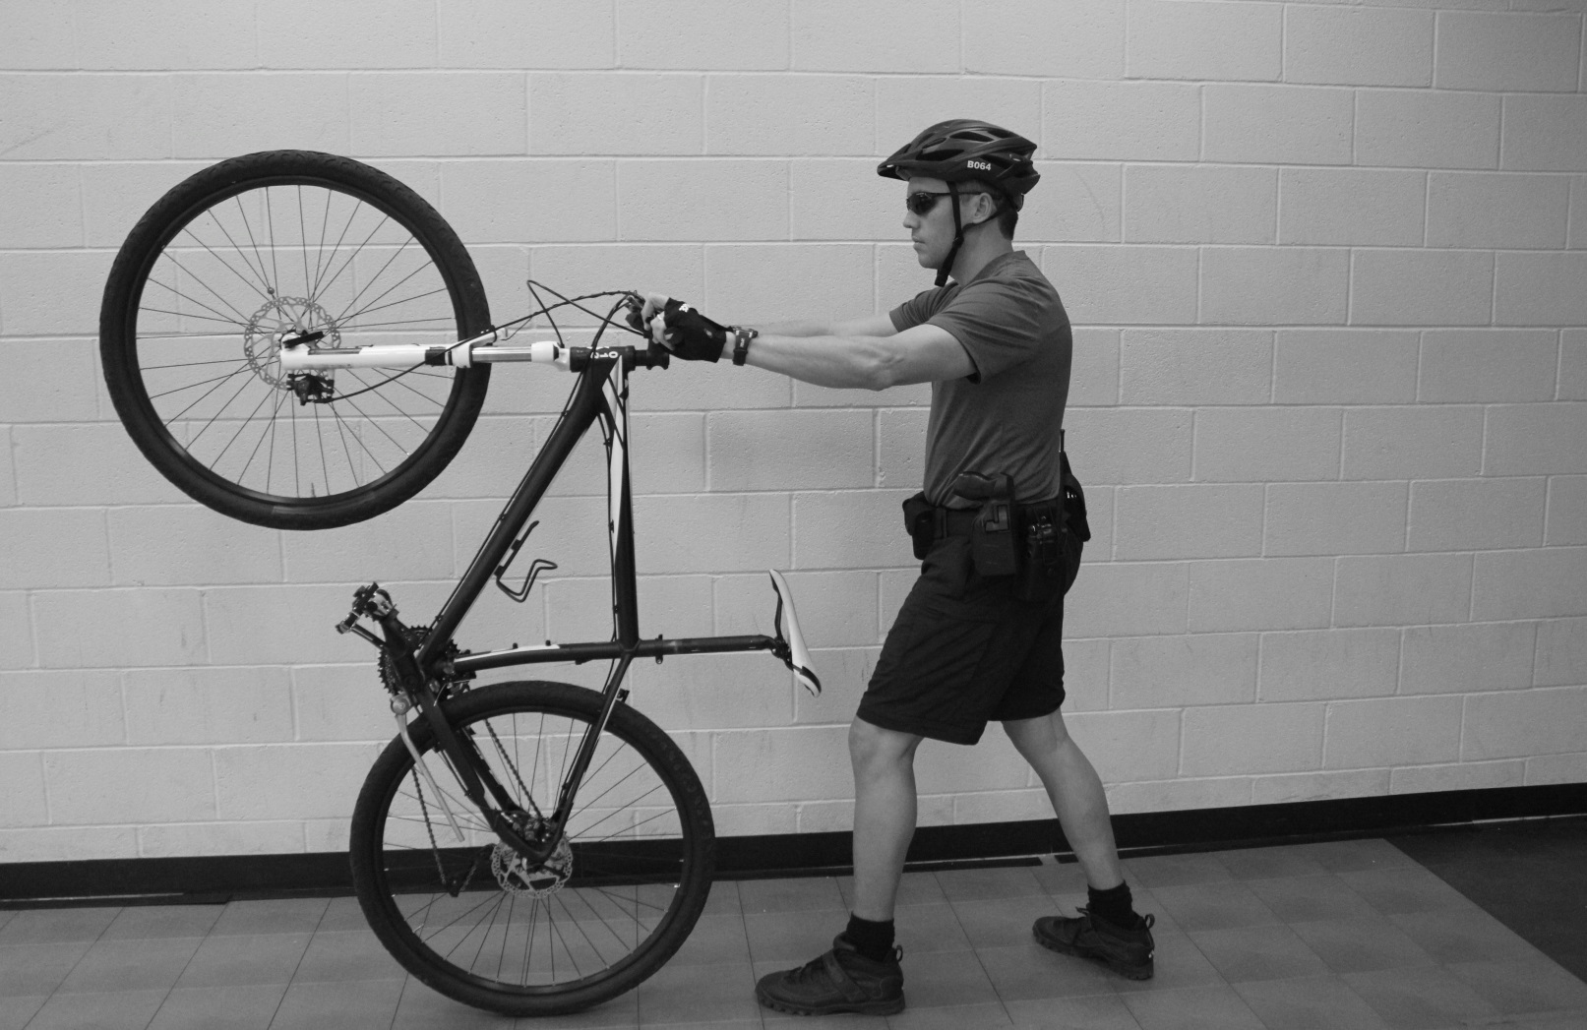
WHEEL UP
From the Crossover Dismount position lock the rear brake and step back allowing the front wheel to leave the ground.

Slide 22
WHEEL UP
Use the bike as a way to keep the violator at a distance.
Maneuver the bike to maintain distance from the violator. The officer can move the bike continually if the violator attempts to outflank.

Slide 23
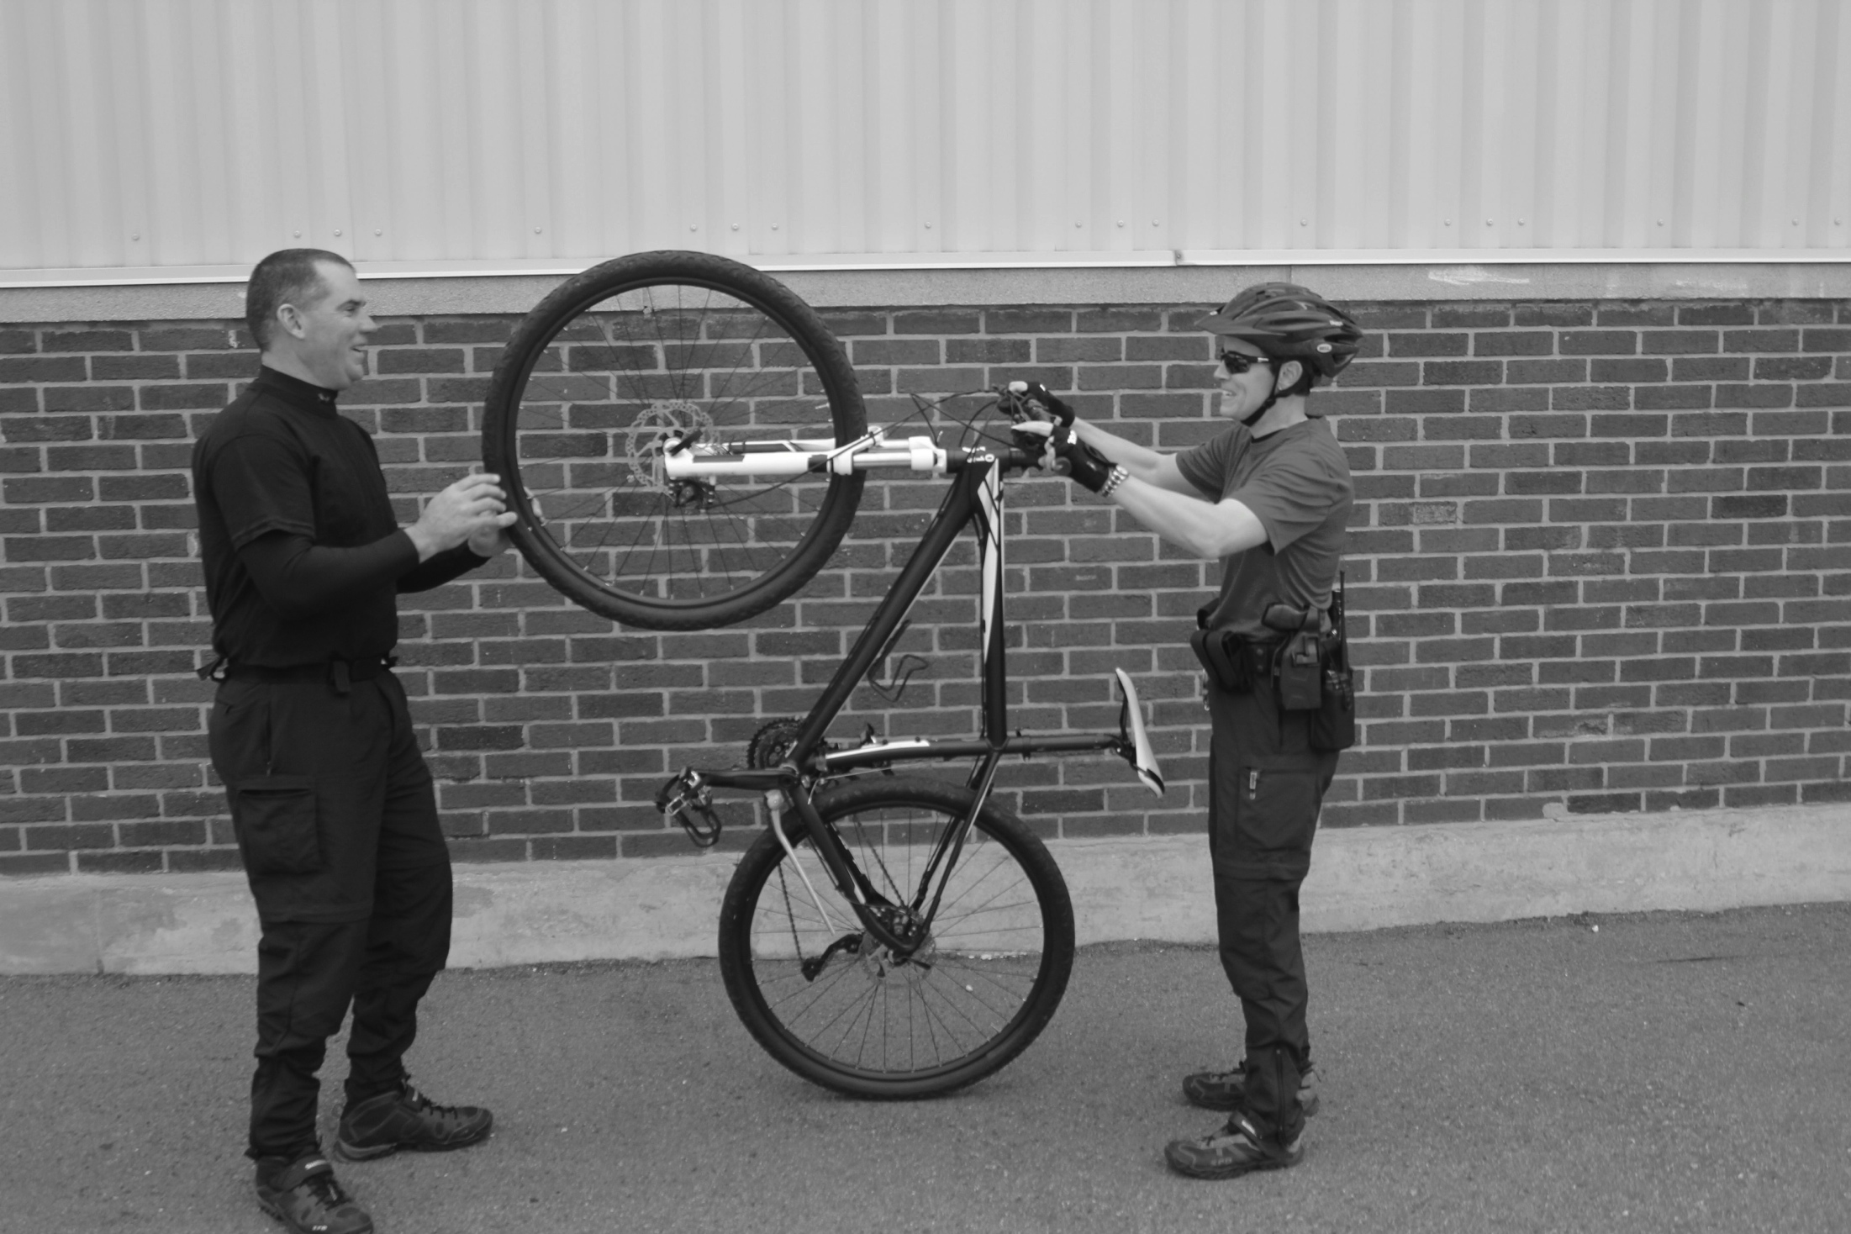
WHEEL UP
Do not lock the front brake. Locking the front brake will allow the violator to gain control of the bike.
REMEMBER: Maneuver the bike to maintain distance from the violator. The officer can move the bike continually if the violator attempts to outflank.

Slide 24
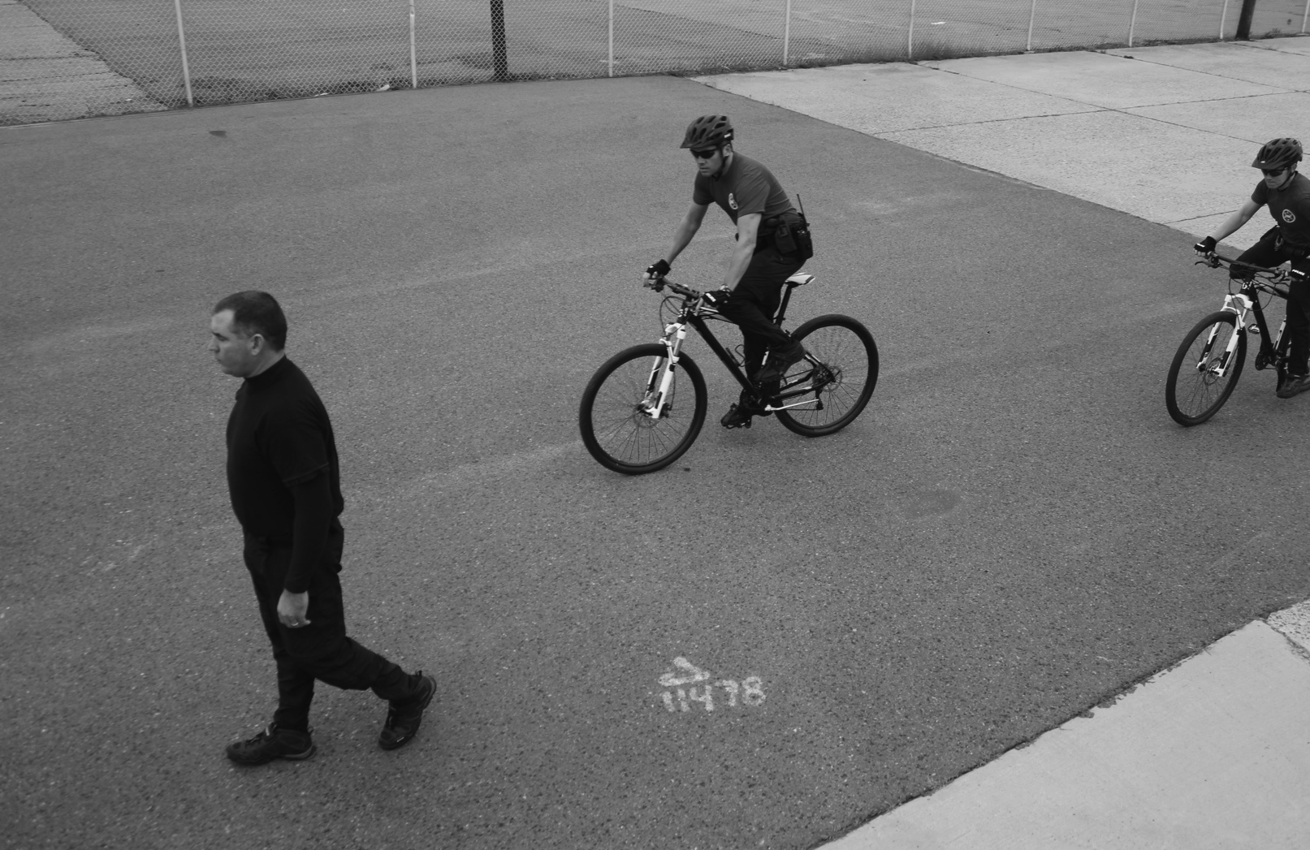
SANDWICH
Officers Approach the violator Ideally from the rear. Communication between the two officers is key.

Slide 25
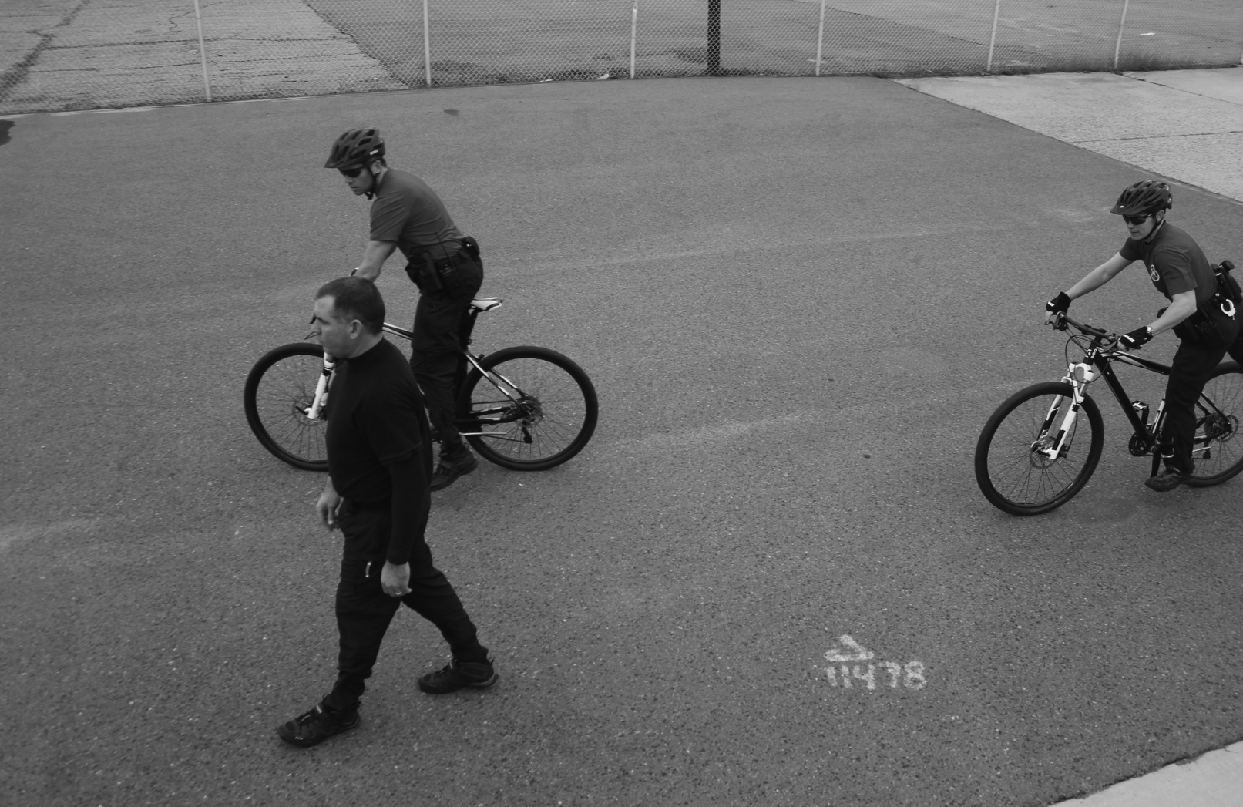
SANDWICH
Front Officer Conducts a Powerslide Dismount. * Note the distance from the violator.
Second Officer Conducts a Running Dismount behind the Violator.

Slide 26
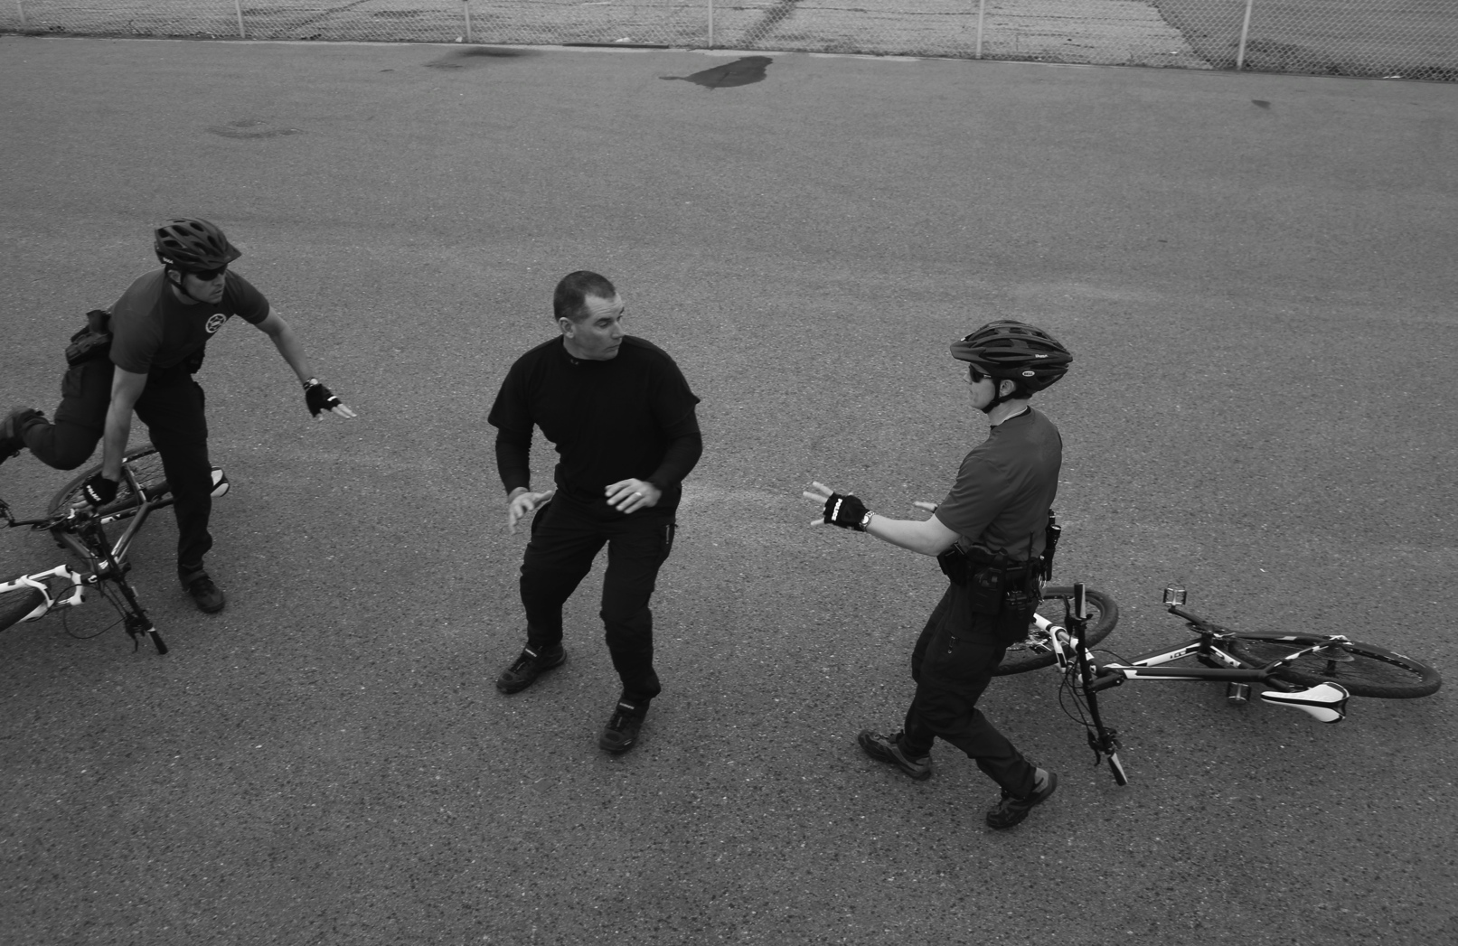
Violator should be surprised by the lead officer actions.
Violator may turn to run, encountering the second officer.

Slide 27
Considerations for all dismounts
A bike does not replace a weapon
Dismount a safe distance away, at least 12 to 15 feet away
Always keep an eye on the violator when dismounting
Be aware of where you drop your bike (trip hazard)
Bicycles afford no protection from firearms or vehicles like a patrol car does

Slide 28
Performance Objectives
List the ways to dismount the bicycle
Identify the 6 defensive bike tactics
Demonstrate the 6 bike tactics

