Slide 1
Effective Cycling
Information for this segment is based in part on the Effective Cycling book written by Mr. John Forester, and the Effective Cycling video – Seidler Productions Inc.
Pages 9-17

Slide 2
Student Performance Objectives
List the five items of safety equipment that are a necessity for a cyclist.
List and demonstrate the three fundamentals of bicycle handling.
Discuss road surface safety and the appropriate steps to avoid road hazards.
Cite the cyclist safety rule
List the five principles of traffic safety.
Notes:
REVIEW PERFORMANCE OBJECTIVES WITH CLASS

Slide 3
Student Performance Objectives (cont.)
List the safety factors to consider when cycling at night.
List the safety factors to take when cycling in the rain.
Discuss the techniques used in hill ascents and descents.
Discuss cycling in groups and describe the responsibilities of the group leader.

Slide 4
5 Items of Safety Equipment
Helmet
Gloves
Eye Protection
Brakes
Toe Clips/Straps, or Clipless Systems
Notes:
REMINDER – HELMETS WILL FORM ITS OWN TOPIC…..
BRING THESE ITMES TO SHOW AND DISCUSS

Slide 5
Training Rides
Increase fitness
Sharpen road skills
Teaches communication skills
To riders and other roadway users
Verbally
Hand signals
Notes:
REMINDER – THESE ITEMS WILL BE PERFORMANCE TESTED DURING THE WEEK

Slide 6
Group Riding
Lead rider(s) usually calls the route and formations
Be predictable to the other riders and roadway users
No jack rabbit starts
Communication
Call out and point to obstacles that may cause a flat or cause someone to go down
Everyone else repeats the call out so entire group knows of the hazard

Slide 7
Group Riding
Pace lines are singles and doubles formations
Stay close to the rider in front of you
Do not overlap tires

Slide 8
Group Riding
During the class we will ride in singles or doubles
(aka ones and twos)

Slide 9
Group Riding
At times we will need to switch from ones to twos and twos to ones
Shoulder checks:
Must be preformed before switching.
Lets you know if its clear to move.
Keeps you informed of your surroundings.

Slide 10
Group Riding
Take the Lane
A lane change
Verbal
AND
Hand signal
Why?
Shoulder check
Verbalize “clear”
From back, to front

Slide 11
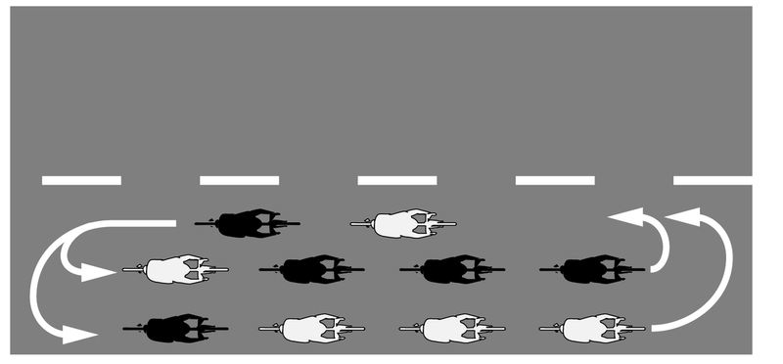
Group Riding
New Lead
Why?
Verbalize
Shoulder check
From front, to back

Slide 12
Group Riding
Other call outs you may here:
Slowing
Move
Wait
Clear
Car back
Downshift
Drink
Notes:
REMINDER – THESE ITEMS WILL BE PERFORMANCE TESTED DURING THE WEEK

Slide 13
Group Riding
Braking
Emergency braking
Both front and rear brakes
Pedals at 3 & 9
Weight over rear axel
Instant Turns
A way to avoid an obstacle quickly
Notes:
REMINDER – THESE ITEMS WILL BE PERFORMANCE TESTED DURING THE WEEK

Slide 14
Road Surface Safety
Gravel
Avoid, do not turn sharply
Drains and grates
Smooth and slippery
Grates can cause falls depending on angle with your tire
Road“turtles” (lane dividers)
Painted areas
Notes:
Lactic acid waste product. How to use it and get rid of it.
AT

Slide 15
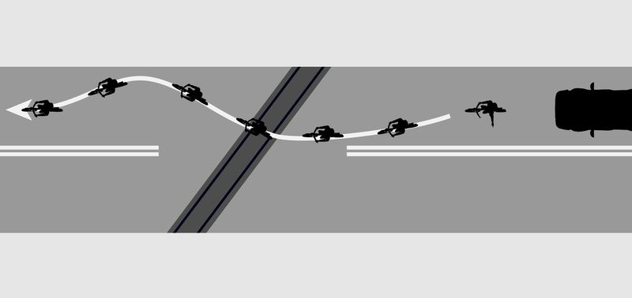
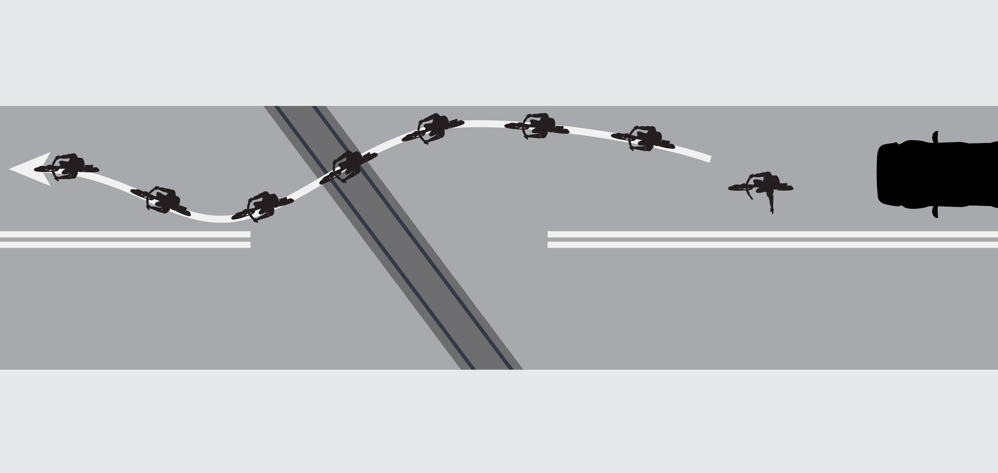
Road Surface Safety
Railroad tracks
Cross at 90 degrees or as close to as possible
Maintain a signal lane
Can be done in ones or twos (communication)
Notes:
Lactic acid waste product. How to use it and get rid of it.
AT

Slide 16
Traffic Safety
“Cyclists Fare Best When They Act and Are Treated as Drivers of Vehicles”.
…John Forester
Notes:
REPEAT AS THIS WILL COME UP A NUMBER OF TIMES THROUGHOUT THE WEEK

Slide 17
5 Principles of Traffic Safety
Drive on the right side of the road.
Yield to cross traffic.
Lane Positioning
Yield when changing lanes.
Speed positioning.

Slide 18
5 Principles of Traffic Safety
1. Drive on the right side of the road.
Exceptions?
Country roads
One way roads
Notes:
HAVE STUDENTS DISCUSS THE REASONS WHY

Slide 19
5 Principles of Traffic Safety
2. Yield to cross traffic.
Who has right of way
Pedestrians

Slide 20
5 Principles of Traffic Safety
3. Lane Positioning
Rule of thirds
Right turn, right most lane
Lane choice
Destination positioning
Multi destination lanes
Merging with, and merging traffic
Notes:
DRAW OUT ON WHITE BOARD FOR DISCUSSION AND VISUAL INTERPRETATION

Slide 21
5 Principles of Traffic Safety
4. Yield when changing lanes
Shoulder check
Signaling
How, and when
Notes:
REMINDER – THESE ITMES WILL BE PERFORMANCE TESTED DURING THE WEEK
REMINDER – THESE ITEMS WILL BE PERFORMANCE TESTED DURING THE WEEK

Slide 22
5 Principles of Traffic Safety
5. Speed positioning
Allow for conditions
If you are as fast as vehicles – Take the lane

Slide 23
Riding In The Rain
Keep dry
Gortex
Protect against cold
Layer
Be visible
Bright clothing
Avoid – metal, paint, lane markers, lane position ‘B’, leaves, puddles.

Slide 24
Riding at Night
Great time to RIDE!
Can be dangerous because of limited vision
43% of all bicycle deaths occur between 8 PM & 8AM
Be Seen
Lights
Reflectors
Reflective gear

Slide 25
Hills
Stay to the right
Single file when ascending
Fast as a car – take the lane
Equalize heat in rims when descending
Lean into turns
Too much speed, slide out rather than leaving the road

Slide 26
Summary
These effective cycling techniques are essential for safety and confidence while cycling on or off road. The more you cycle and practice these skills, the less likely you will be involved in a mishap.
“Cyclists Fare Best When They Act and Are Treated as Drivers of Vehicles”.

Slide 27
Student Performance Objectives - Review
List the five items of safety equipment that are a necessity for a cyclist.
List and demonstrate the three fundamentals of bicycle handling.
Discuss road surface safety and the appropriate steps to avoid road hazards.
Cite the cyclist safety rule
List the five principles of traffic safety

Slide 28
Student Performance Objectives - Review (cont.)
List the safety factors to consider when cycling at night.
List the safety factors to take when cycling in the rain.
Discuss the techniques used in hill ascents and descents.
Discuss cycling in groups and describe the responsibilities of the group leader.

