Slide 1
Gears & Cadence
Pages 43-47

Slide 2
Student Performance Objectives
State the two cross-over gears and why they should be avoided.
State what duplicate gears are and how they effect the number of gears available for use.
Be able to state the preferred cadence.

Slide 3
How many gears are there on a MTB?
1, 2 or 3 on the front, called chain rings.
8, 9 or 10 on the rear, called cogs.
Multiply front number of chain rings by rear number cogs
Example: 3 (chain rings) X 9 (cogs) = 27

Slide 4
Gear Inches
Gear inches is how far the bike will travel with one pedal revolution.
Pedal the bike one revolution.
Measure the distance between the starting point and the ending point of the bike.

Slide 5
Duplicate Gears
Cogs Granny 26 Middle 36
22
23 29.3”
31
32 29.2”
More gears = more duplicate gears. A 27 speed bike has about 5 duplicate gears.

Slide 6
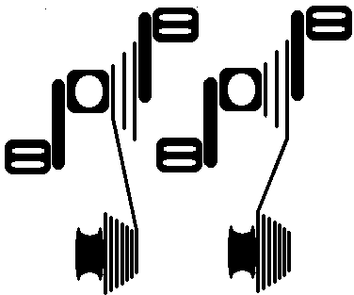
Crossover Gears
Small - Small Large – Large
or
Little – Little Big - Big
Notes:
You do not want to ride in these gears.
Stretch the chain and derailleur to the maximum in big - big
Wear out chain rings faster than normal gear, because of angles
Chain can bounce off when in little – little gear combo

Slide 7
Crossover Gears
This causes extra wear on the chain and gearing
Easier to have the chain skip, derail or break
Notes:
You do not want to ride in these gears.
Stretch the chain and derailleur to the maximum in big - big
Wear out chain rings faster than normal gear, because of angles
Chain can bounce off when in little – little gear combo

Slide 8
How many usable gears are there on a MTB?
As we said earlier, 27. Now take away crossover gears (2) and duplicate gears (5).
Your bike has about 20 different gears ratios.
If someone asks you how many gears you bike has – Use the standard of front X rear.

Slide 9
Cadence
Cadence is how many pedal revolutions you make in a single minute.
Count your pedal revolutions for 15 seconds and X by 4.
“20 revolutions X 4 = 80”
The preferred range is 75 -99.

Slide 10
Cadence
It is important to use the 75 – 99 rpms for almost all of your riding.
Down shift at stops, puts you in an easier gear to start.
It will help you ride more efficiently as well as help prevent injury.

Slide 11
Cadence
Keeps you in an aerobic system.
If you are at 110 rpms, your heart rate will sky rocket (going anaerobic).
If you are at 45 rpms, your legs are working way to hard (like doing squats for the entire ride).

Slide 12
Student Performance Objectives
State the two cross-over gears and why they should be avoided.
State what duplicate gears are and how they effect the number of gears available for use.
Be able to state the preferred cadence.

Slide 13
Summary
If you consistently shift and stay in the preferred 75 – 99 rpm’s, you will have energy and strength to maximize your performance during your entire shift.

