Slide 1
Non-Collision Cycling Injuries
Pages 31-36

Slide 2
PERFORMANCE OBJECTIVES
List the three most common injuries associated with the foot and discuss the treatment of each injury.
List the six most common injuries associated with the knee and discuss the treatment of each injury.
List the two most common injuries associated with the hand and discuss preventative steps for each injury.
List three common issues associated with the saddle and discuss preventative steps and treatment.

Slide 3
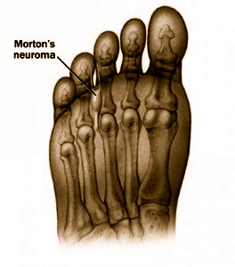
FOOT INJURIES
Morton's Neuroma - the compression of the plantar nerve which is located between the metatarsal heads which runs between the third and forth toes.
Carolina Foot Specialists; www.carolinafootspecialistsnet/neuromas.html

Slide 4
Symptoms
Pain is shock like and sometimes recurring and tingling.
Occurs over time.

Slide 5
Treatment
Wear correct shoes (cycling shoes).
With your cycling shoe in your hand, try to bend the shoe using two fingers.
Cycling shoes should be difficult to bend.
Use soft orthotics.
Over the counter orthotics may work.
May need to see a podiatrist.

Slide 6
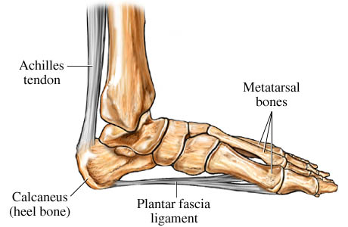
FOOT INJURIES
Plantar Fasciitis- the stretching of the ligament connecting the toes to the heel.
_{www.flyingpigmarathon.com}

Slide 7
Symptoms
Foot is flexing to much.
Pain in the arch of your foot. Feels like it is tearing or being cut.

Slide 8
Treatment
Wear correct shoes (cycling shoes).
With your cycling shoe in your hand, try to bend the shoe using two fingers.
Cycling shoes should be difficult to bend.
Use soft orthotics.
Over the counter orthotics may work.
May need to see a podiatrist.

Slide 9
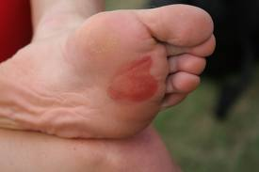
Blisters
Blisters - A small pocket of fluid within the upper layers of the skin. Usually caused by friction.

Slide 10
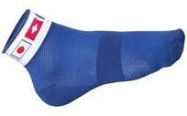
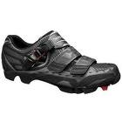
Treatment
Wear tight fighting socks.
Wear properly fitting cycling shoes.

Slide 11
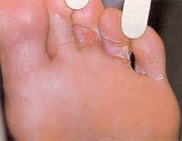
Athletes Foot
Athletes Foot- A fungal infection of the skin that causes scaling, flaking and itch of the affected areas. Transmitted in moist areas where people walk barefoot, such as showers or bathhouses. Can spread to other areas of the body, including the groin.

Slide 12
Treatment
Wear clean socks.
Change socks often.
Keep feet clean.
Use medicated powder or cream on feet.
Avoid moist areas such as communal showers.

Slide 13
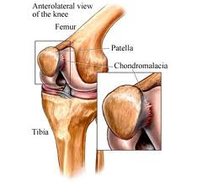
Knee Injuries
Chondromalacia- genetics or a previous injury such as a fracture or a dislocation which may have moved the patella (knee cap). Low seat height may cause constant pressure because the knee is consistently flexed. Also, weak quads, which allow the knee cap to slide.
Notes:
#1 type of knee injury

Slide 14
Treatment
Symptoms
Pain with a grinding sensation and audible cracking the kneecap when walking or bending, especially after exercise.
1. Elevate the knee and ice it after riding.
Spin in low gears.
2. Check seat height – usually too low. Also, make sure the knee bends 15-25 degrees at the bottom of the pedal stroke.

Slide 15
Medial Capsular Injury -an irritation of the medial (inside) synovial wall, sometimes accompanied by irritation of the thin bands known as the synovial plicas.
Symptoms
Pain inside the joint, where the thigh-bone meets the knee.

Slide 16
Treatment
1. Check seat height – usually too low.
2. Spin pedals easily.
3. Strengthen your medial quads with leg extensions but avoid squats.
Weak quads is the number 1 reason new bike Officers complain of sore Knees.

Slide 17
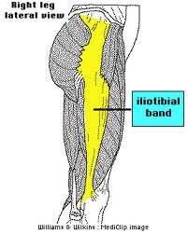
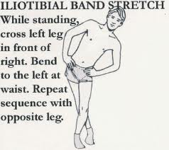
Iliotibial Band Syndrome -the friction created as the Iliotibial band rubs over the femur (thigh bone).

Slide 18
Treatment
Symptoms
Stabbing pain near the bony protrusion on the outside of the thighbone. The ITB may also be swollen and tender to the touch.
1. Use ice.
2. Massage and use anti-inflammatory medication.
3. Adjust saddle height properly – usually too low.

Slide 19
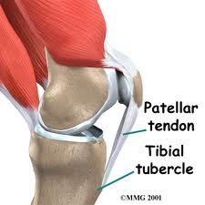
Patella Tendonitis - inflammation of the patella tendon either at the knee cap or where it joins the tibia (shin bone).

Slide 20
Treatment
Symptoms
Inflammation of the patella tendon, the area is tender to the touch, there is pain during and after riding. Sometimes the tendon itself seems to change shape due to swelling.
Check seat height – usually too low
Ice the knee after riding.
Spin in low gears with cadence above 80 RPM.

Slide 21
Treatment
Quadricep Tendonitis - inflammation of the quadriceps tendon where it meets and passes over the knee cap.
Symptoms
Inflammation of the quadriceps tendon that causes pain to the touch, with swelling above the kneecap, about 3” up the thigh.
1. Check seat height – usually too low.
2. Ice knee.
3. Spin in low gears.
4. Use anti-inflammatory medication.

Slide 22
Treatment
Hamstring Tendon Strain - stretching of the large tendons behind the knee and thigh.
Symptoms
Pain at the back of the knee and thigh, and the tendon behind the knee leading up to the buttocks is sore and tender to the touch.
Check seat height – usually to HIGH.
Spin in low gears.
Do not use cleated shoes and do not pull up in the pedaling motion.
After riding, gently stretch the hamstring and apply ice.

Slide 23
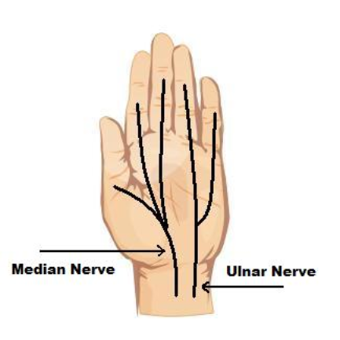
Hand Injuries
Guyon’s Syndrome - a compression of the nerves running along the underside of the palm and extending into the little and ring.

Slide 24
Carpel Tunnel Syndrome (CTS) - a compression of the large nerve that supplies power and sensation to the thumb, middle and index finger.

Slide 25
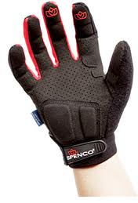
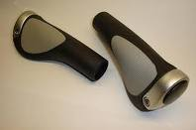
Treatment
1. Wear padded gloves.
2. Get in proper position.
3. Stretch hands before riding.
4. Use padded grips on handlebars.

Slide 26
Saddle Injuries
Bicycle officers:
- Ride an average of 15-40 miles per day.
- Three points of contact on bike, most notably the saddle.
- Most common complaint of police cyclists.
Notes:
Pass out the “human skeleton” handout.
Show where the ischial tuberosites are located on the handout.

Slide 27
Saddle Injuries
1. Pressure to the ischial tuberosities.
2. Mid-thigh chafing.
3. Ichemic neuropathy
4. Lesions and Infections. (Saddle Sores)

Slide 28
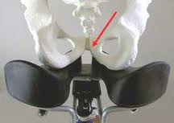
Points of contact on saddle
Ischial Tuberosities – The “sit bones” or the bony structure at the bottom of the pelvis.

Slide 29
Treatment
Proper seat tilt.
Male = near level tilt
Female = near level tilt
Use a gel saddle (not gel cover) or cycling specific shorts.
Proper shaped seat
Women may need a wider, female specific or different shaped saddle.

Slide 30
Different shaped seats may help both men and women in preventing the compression of the Pudendal nerve.
ROUND
TOP
FLAT
TOP
WIDER
WEDGE
HOLE
SPLIT

Slide 31
Lesions, Infections & Chafing
Three causes of saddle sores:
Pressure
Friction
Infection
Choose a good pair of cycling shorts.
Needs to cover to the mid thigh to prevent saddle chafing.
Comfortable, wicking fabric.
Tight fitting (can be worn under patrol shorts).
Do not wear underwear under cycling shorts.

Slide 32
Common Infections
Furuncles – a boil, is a deep infection of the hair follicle. It is almost always caused by infection by bacteria, resulting in a painful swollen area on the skin caused by an accumulation of pus and dead tissue.
Carbuncles – An abscess larger than a boil, usually with one or more openings draining pus onto the skin. Usually caused by bacterial infection. Is contagious and can spread to other areas of the body or other people.

Slide 33
Treatment
Warm Compresses.
Keep body and affected area clean, use a wash cloth.
Use of anti bacterial soap can be used to prevent infection.
Keep shorts clean.
Dry in direct sun light to kill bacteria.
Extensive conditions may need antibiotics, drainage or incisions.
Consult a physician.
Riding should cease until completely healed.

Slide 34
Ischemic Neuropathy
A compression of the nerves causing a tingling and numbing sensation to the penis. Caused by the compression of the Pudendal Nerve.
Treatment
A repetitive type of injury
Check Bike Fit (height, tilt, fore & aft position)
Use padded cycling shorts, gel seat (not a gel cover)
Try a different seat that fits your body type (lots available)
There is a ”break in” period to get used to the seat
All else fails:
Stop riding
Consult a physician

Slide 35
Common prevention for saddle injuries
Proper bike fit and seat tilt
Wear clean shorts everyday
Wear smooth/soft underwear or cycling specific shorts
Wear shorts that are at least mid-thigh length
Keep the area clean, use a wash cloth
Use anti-bacterial soap
Use a topical cream
Change position on the seat
Change style of seat
If conditions persist, seek medical attention

Slide 36
Review
List the three most common injuries associated with the foot and discuss the treatment of each injury.
List the six most common injuries associated with the knee and discuss the treatment of each injury.
List the two most common injuries associated with the hand and discuss preventative steps for each injury.
List three common issues associated with the saddle and discuss preventative steps and treatment.

