Slide 1
Falling & Collision injuries
Pages 38 - 39

Slide 2
PERFORMANCE OBJECTIVES
List treatments for road rash.
Identify what the number one post injury concern is for road rash.
Identify what the acronym RICE stands for
List signs of a head injury.

Slide 3
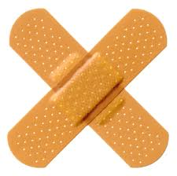
Basic First Aid
Cycling and the instruction of police bicycle training is inherent to injuries along the way.
Basic First Aid knowledge is essential to treating injuries and assessing those injury for possible need of advanced medical attention.

Slide 4
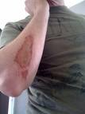
Basic First Aid
Road Rash – Caused by sliding across the ground removing the outer layers of skin.

Slide 5
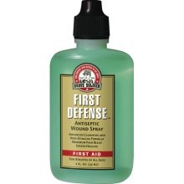
Road Rash
Treatment:
Direct pressure to control the bleeding.
Once the bleeding is controlled, you can observe gravel, dirt, etc. in the wound.
Removed debris to prevent infection.
Apply antiseptic spray, helps infection and pain.

Slide 6
Road Rash
Treatment:
Use sterile gauze to push the debris out of the wound.
Irrigate wound with clean water or solution.
Cover wound while at work.
Clean and dress wound regularly.
Check for signs of infection (#1 issue with road rash).
Red streaks coming from wound.
Seek medical attention.
Severe road rash – seek medical attention

Slide 7
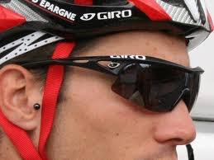
Basic First Aid
Eye Injuries
Without eye protection you risk serious injury to your eyes.
When contaminants enter the eye, flush them with plenty of water. Use your water bottle when no other means are available.
Any trauma to the eye must be treated at once.

Slide 8
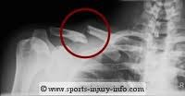
Basic First Aid
Fractures
Clavicle
Frequently injured during cycling falls.
Treatment should include immobilization and ice.
Seek immediate medical treatment
Arm
Most commonly the wrist.
Treatment should include splinting the area and ice.
Seek immediate medical treatment.

Slide 9
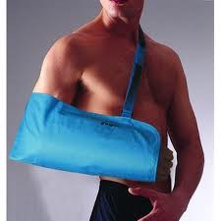
Basic First Aid
Sprains
Sprains, contusions and fractures are common injuries of the wrist in cycling.
Treatment should include splinting, ice and elevation.
Seek immediate medical attention.
An X-ray should be taken to determine if the wrist is fractured.

Slide 10
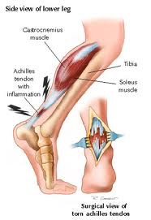
Basic First Aid
Tears of the Achilles tendon
Injures to he Achilles tendon occur in cycling, usually during an all out sprint after a suspect or very hard peddling in a hard gear combination.
Usually painful and sometimes makes a loud snap.
Treatment is ice, elevation and immediate medical treatment.

Slide 11
Basic First Aid
Sprains of the foot
Often occur when getting the foot caught in the toe clips when attempting to dismount.
Treatment is RICE – Rest, Ice, Compress, Elevate
Seek medical treatment.
Head Injuries
Most common cause of death in athletics.
A significant impact to the head should checked for signs of a concussion or immediate medical attention!

Slide 12
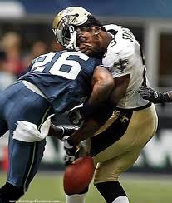
Head injuries
Symptoms of a head injury may be present up to 48 hours after the injury. Symptoms include:
Dizziness or loss of coordination
Blurred or double vision
Unequal pupil size
Severe headache
Ringing in the ears
Nausea and/or vomiting
Slurred speech, disorientation
Convulsions or tremors
Sleepiness or grogginess
Clear fluid draining from ears or nose
Numbness or paralysis
Difficulty in being aroused.

Slide 13
PERFORMANCE OBJECTIVES
List treatments for road rash.
Identify what the number one post injury concern is for road rash.
Identify what the acronym RICE stands for
List signs of a head injury.

