Slide 1
Dehydration, Hyponatremia, Heat & Cold
Pages 52-53

Slide 2
PERFORMANCE OBJECTIVES
List the common symptoms associated with dehydration
Describe the condition of hyponatremia
List symptoms of heat exhaustion and heat stroke
Cite ways to prevent hypothermia

Slide 3
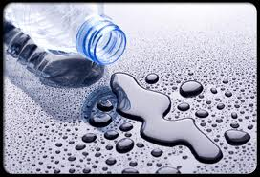
Dehydration
Should not be overlooked – part of nutrition
Known to significantly affect body temperature and blood circulation
Can increase the body’s core temp and decrease cardiac output
Notes:
To prevent dehydration drink plenty of water before and during exercise.
Drink8-10 ounces of water every 1/2 hour or one full water bottle every hour.
Water is the best fluid. Some fluid replacement drinks contain high levels of electrolytes which can cause fluids to leave the cells and go into the stomach.
Also be aware of heat exhaustion-high core temp,no sweat
and heat stroke-- kills 4000 people a year

Slide 4
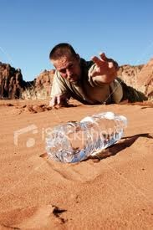
Dehydration
Occurs when the body has exhausted all of its fluid reserves
Common symptoms:
Thirsty
Dry Mouth
Dark, Strong smelling urine
Lack of the need to urinate
Headache
Cramps

Slide 5
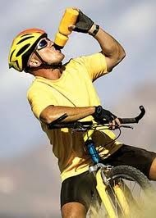
Dehydration
Prevention:
Drink plenty of water before, during and after exercise
Keep bike bottle or backpack bladder half-full at all times
Drink 8 – 10 oz. of water every half-hour
Slow, steady intake

Slide 6
Hyponatremia
When the body has a very low blood sodium concentration
Usually occurs with heavy sweating combined with excessive intake of water only
Common symptoms:
Nausea
Muscle Cramps
Disorientation
Slurred speech
Confusion

Slide 7
Hyponatremia
Prevention:
Eat a balanced diet
Drink water and drinks containing sodium
Eat sport supplements (energy bars, etc.) during stops
Treatment:
Immediate ingestion of sodium via liquid or food
Seek medical attention

Slide 8
Heat Exhaustion / Heat Stroke
Shared symptoms include fatigue, dizziness, nausea, headache, excessive thirst, muscle cramps, increased heart rate & confusion
Heat exhaustion symptoms include:
Excessive sweating
Cold, clammy skin
Heat stroke symptoms include:
Absence of sweating
Hot, flushed, dry skin
Impaired consciousness
Convulsions
Treatment for both:
Move to cool, shaded area
Administer fluids & salts
Seek medical attention

Slide 9
Hypothermia
Insufficient heat in the body’s core
Level I
Loss of judgment because the brain is dulled by cold. Become confused, lost, drop gear, less coherent to others
Level II
Loss of fine motor skills, shivering
Level III
Uncontrollable shivering, confusion, loss of fine motor skills, numbness in extremities
Level IV
Profound Hypothermia, brain loses gross motor coordination, body grows cold and rigid, pulse & respiration decrease, core temp is 10 degrees below normal

Slide 10
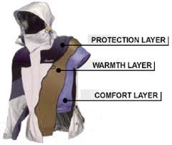
Hypothermia
Prevention
Wear layered clothing that retains its insulating qualities when wet
Remove layers before you heat up and put them back on before you cool down
Drink plenty of fluids, but not alcohol
Eat for sustained exercise and load up on complex carbs
Pace your energy output

Slide 11
Review
What are some symptoms which are common to dehydration?
Describe the condition of hyponatremia
State major differences between heat exhaustion and heat stroke
List some ways to prevent hypothermia

