Slide 1
Proper helmet fit
Pages 18-21

Slide 2
Student performance objectives:
Identify the Importance of Helmets
List Five Types of Certifications
Be able to properly fit a helmet
Determine when to replace

Slide 3
ALL PARTICIPANTS INVOLVED IN LEBA BIKE COURSES MUST WEAR PROPERLY APPROVED BICYCLE HELMETS WHENEVER THEY ARE MOUNTED ON THE BIKE.

Slide 4
IMPORTANCE OF HELMETS
REDUCE RISK OF HEAD INJURY BY 85%
REDUCE RISK OF BRAIN INJURY BY 88%
* Per National Safe Kids Campaign

Slide 5
CERTIFICATIONS
CPSC USA AND CANADA
ASTM USA AND CANADA
ANSI USA AND CANADA
SNELL USA AND CANADA
CSA CANADA
***DOT DOES NOT CERTIFY BICYCLE HELMETS***

Slide 6
Helmet size
Place Helmet on Head
With Helmet on and unbuckled tighten retention device until comfortable.
Bend forward from the waist tipping your head forward.
The Helmet should stay on.
Places hands below helmet to catch it if it does not stay on.

Slide 7
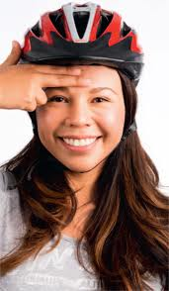
Two finger test
When in the proper position the bottom edge of the Helmet should be within one or two finger widths from your eyebrows or bridge of your nose.

Slide 8
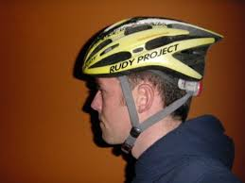
Y straps
Adjust the front and rear straps properly
The buckle of clasp that joins the two straps should be centered no more than an inch below the earlobe.

Slide 9
Chin Strap
Buckle should remain tight enough so the strap will not slip over the chin.
Good rule of thumb is to leave one or two finger widths between the strap and the chin

Slide 10
Final test
With the helmet on, properly placed, and straps secured
Grasp the helmet in your hands gently
Twist it from side to side and Up and down
As you make these movements the skin under the helmet should move also.
If the helmet moves freely it is to loose

Slide 11
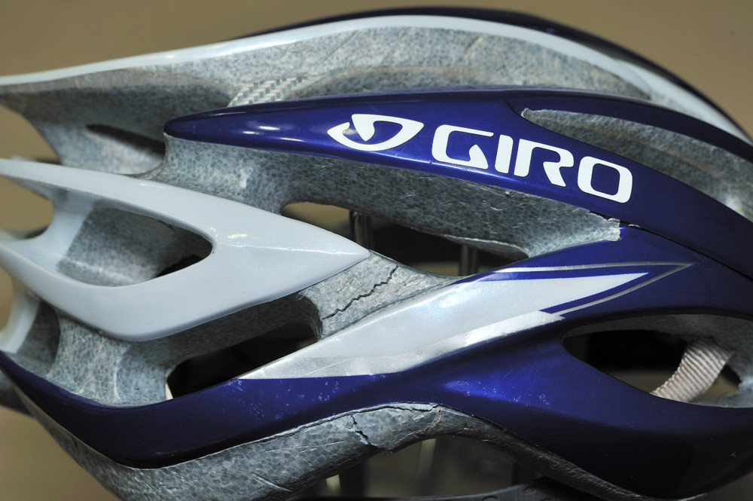
When should I replace my helmet
Did you crash it?
Is it from the 1970’s ?
Are their dings, nicks or cracks?
Is the outside just foam or cloth instead of plastic?
Does it lack CPSC, CSA, ASTM, or Snell sticker?
Can you not adjust it to fit properly?
Do you hate it?
If YES to any of these then it is time to replace.

Slide 12
Student performance objectives:
Identify the Importance of Helmets
List Five Types of Certifications
Be able to properly fit a helmet
Determine when to replace

