Slide 1
Guns, Knives & Melanoma
Pages 55-56

Slide 2
PERFORMANCE OBJECTIVES
List the three forms of skin cancer and discuss the measures to take to avoid them.
List 4 ways to avoid the risk of sun damage to the skin.

Slide 3
Skin Cancer
The sun produces two types of radiation:
1. UV-A - the good type responsible for tanning
2. UV-B - the bad type responsible for sunburns

Slide 4
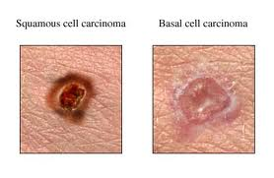
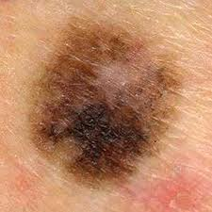
Skin Cancer
Three types of skin cancer:
1. Basal Cell Carcinoma
2. Squamous Cell Carcinoma
3. Malignant Melanoma
Notes:
Bc--least dangerous form. Small fleshy bump on the head, neck or hands.Does’t grow rapidly and rarely spreads to other body parts. If left untreated it can grow below the skin and into the bone. Cure rate is 95 % with surgery
SC-- tumors look like red scaly patches. Typically found on the face ,ears, lips and mouth.955 cure rate with surgery
MM _- This is the killer. very dark patch of skin, usually developing in an existing mole ect.most always curable if caught in an early stage.

Slide 5
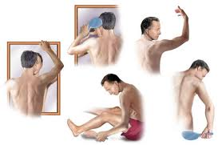
10 steps to avoid risk:
1. Examine yourself
2. Use sunscreen rated SPF 15 or higher
3. Cover-up
4. Do not count on dark skin to save you
5. Do not count on a bottled tan for protection
Notes:
examine yourself-- examine parts that you can see without a mirror
then use a full length mirror and a hand mirror to examine you backside etc....or get wife or girlfriend or both to do it.
Spf--use water resistant...apply 30 min before shift begins to allow the product to work
Cover up-clothes do not block all uv rays. Tightly woven cotton is the best
Dark skin- you might be a naturally dark skinned person or black but you are not immune to sun damage
Do not count on a bottle tan for protection--skin darkeners have no sunscreen

Slide 6
6. Ride early or late in the day
7. Use more sunscreen and protective wear at higher altitudes
8. Be aware of rainy rides
9. Eat right
10. Start protecting young
Notes:
Ride early- the hours of highest uv exposure is between 10 am and 300 pm
eat right--there is some evidence that a low fat diet may protect your skin
Start protecting young-75% of all skin cancer is related to burns that occurred before the age of 20

Slide 7
Review
List the three forms of skin cancer and discuss the measures to take to avoid them.
List 4 ways to avoid the risk of sun damage to the skin.

